Slide 1
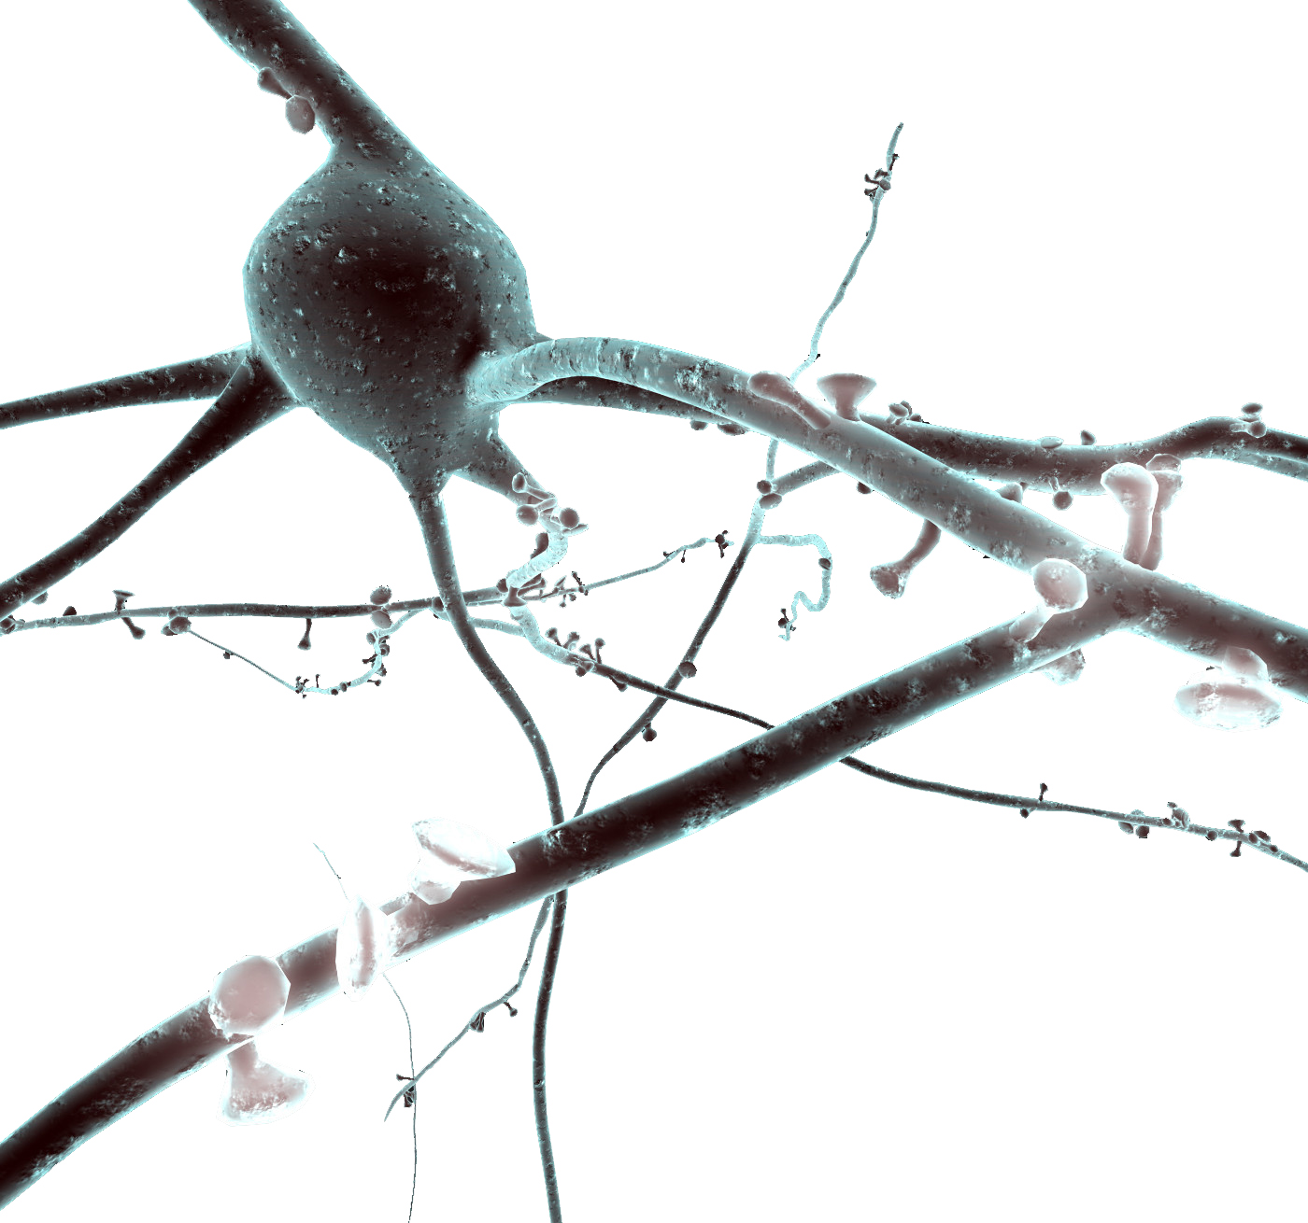
Using NEURON to model cells Tutorial
Oren Amsalem:
oren.amsalem1@mail.huji.ac.il
Idan Segev Lab
https://github.com/orena1/NEURON_tutorial

Slide 2
Introduction
Read More About NEURON
The NEURON Simulation Environment is designed for modeling individual neurons and networks of neurons.
It is particularly well-suited to explore problems which are closely linked to experimental data.
NEURON was build and is maintained by Ted Carnevale and Michael Hines, lately the Blue Brain Project is becoming heavily involved with the development of the software
Neuron is written in C & C++, the interface with the simulator is with HOC, but a python wrapper was build and now commonly used instead of HOC (NEURON is used as a python package). In addition User-defined mechanisms such as voltage- and ligand-gated ion channels are used in order to expand NEURON (mod files, need to be compiled).
In this presentation I will show the following examples:
Single compartment model
Ball and Stick model and a replication of a published result (Gidon et al.)
Layer 5 Pyramidal cell and two replications of published results (Hay et al., Doron et al.)
This presentation is accompanied with jupyter notebooks which contain the complete code of each example - https://goo.gl/pke4hk (nrnivmodel mods)

Slide 3
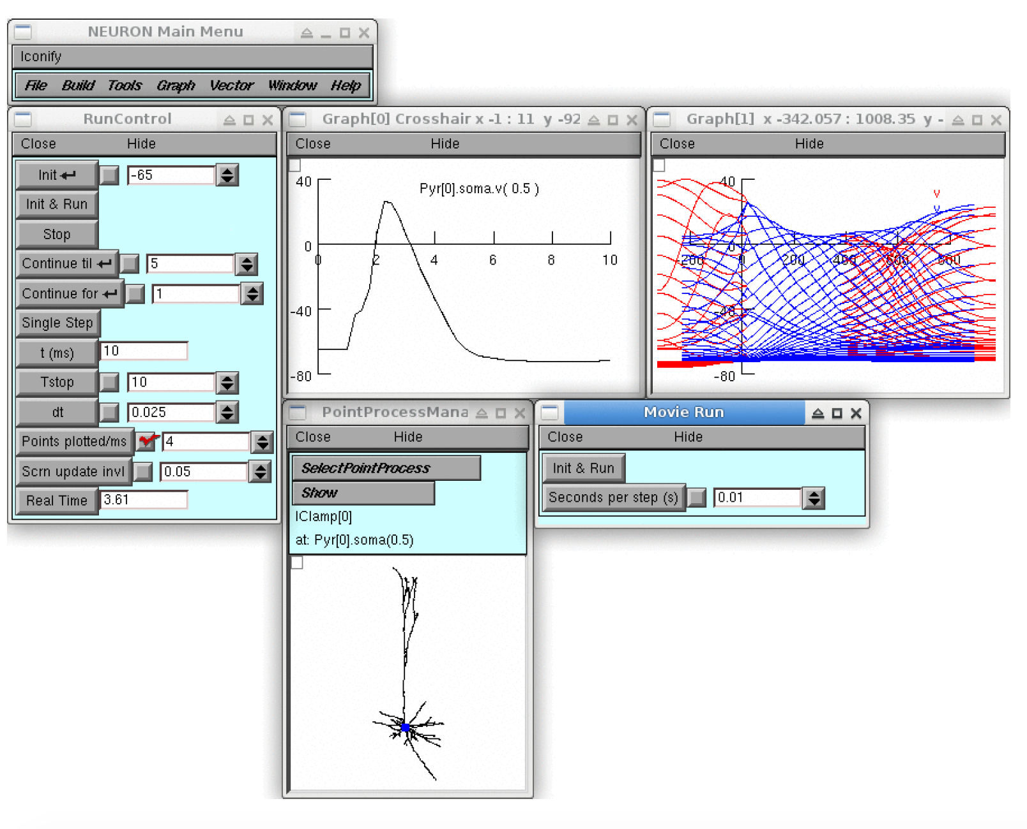
NEURON GUI

Slide 4
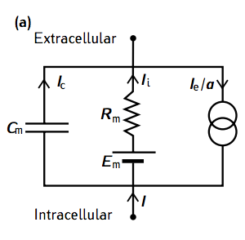
Single compartment neuron - passive
from neuron import h
# create model
h("create soma")
h.soma.L = 10 # length µm
h.soma.diam = 10 # diameter µm
h.soma.insert('pas') # add passive properties
h.soma.g_pas = 1/10000 # set the specific membrane
# resistance to 10000 ohm*cm^2
# current clamp
stim = h.IClamp(h.soma(0.5))
stim.delay = 20 # start of the current injection (ms)
stim.dur = 100 # duration (ms)
stim.amp = 0.01 # amplitude (nA)
# record voltage of some and injected current
# and the time
soma_v = h.Vector()
soma_v.record(h.soma(0.5)._ref_v)
stim_current = h.Vector()
stim_current.record(stim._ref_i)
t = h.Vector()
t.record(h._ref_t)

Slide 5
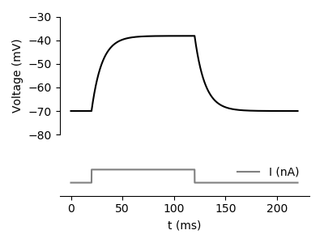
Single compartment neuron - passive
# record voltage of some and injected current
# and the time
soma_v = h.Vector()
soma_v.record(h.soma(0.5)._ref_v)
stim_current = h.Vector()
stim_current.record(stim._ref_i)
t = h.Vector()
t.record(h._ref_t)
# plotting
f, (ax0, ax1) = plt.subplots(2,1, gridspec_kw = {'height_ratios':[3, 1]})
ax0.plot(t,soma_v, 'k')
ax1.plot(t,stim_current, 'gray', label='I (nA)')
# run simulation
h.tstop = 220 # set the simulation time
h.dt = 0.025
h.v_init = -70
h.run()
Notes:
Exercise:
Inject different currents to the neuron and create a figure like this one: http://www.jneurosci.org/content/jneuro/21/3/1067/F8.large.jpg

Slide 6
Single compartment neuron - active
h("create soma")
h.soma.L = 10
h.soma.diam = 10
h.soma.insert('pas') # add passive properties
h.soma.g_pas = 1/10000 # set the specific membrane resistance # to 10000 ohm*cm^2
h.soma.insert('kv') # add potassium channel
h.soma.gbar_kv = 2000 # set the potassium conductance (pS/um2)
h.soma.insert('na') # add sodium channel
h.soma.gbar_na = 8000 # set the sodium conductance
h.celsius = 30
# current clamp
stim = h.IClamp(h.soma(0.5))
stim.amp = 0.007446
Notes:
Exercise:
Inject different currents and check what is the IF curve: http://www.jneurosci.org/content/jneuro/23/37/11628/F1.large.jpg

Slide 7
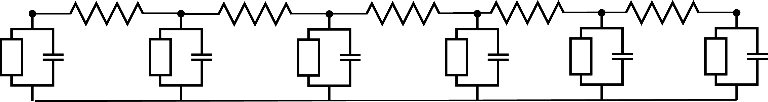
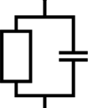
Ball and Stick model
###################
# # Build Model # #
###################
h("create soma")
h.soma.L = 10 # um
h.soma.diam = 10 # um
h.soma.Ra = 100
h.soma.insert('pas')
h.soma.g_pas = 1/10000 # 1/Rm - Rm ohm*cm^2
h("create dend")
h.dend.L = 500 # um
h.dend.diam = 1 # um
h.dend.Ra = 100 # ohm*cm
h.dend.insert('pas')
h.dend.g_pas = 1/10000
h.dend.connect(h.soma, 1, 0) #connect the end of the soma
#to the start of the dendrite
h("forall { nseg = int((L/(0.1*lambda_f(100))+0.9)/2)*2 + 1 }") # set the number
#of segments
Soma
Dendrite
R_{s}
R_{d0}
R_{d3}
d_lambda rule – NEURON book p50

Slide 8
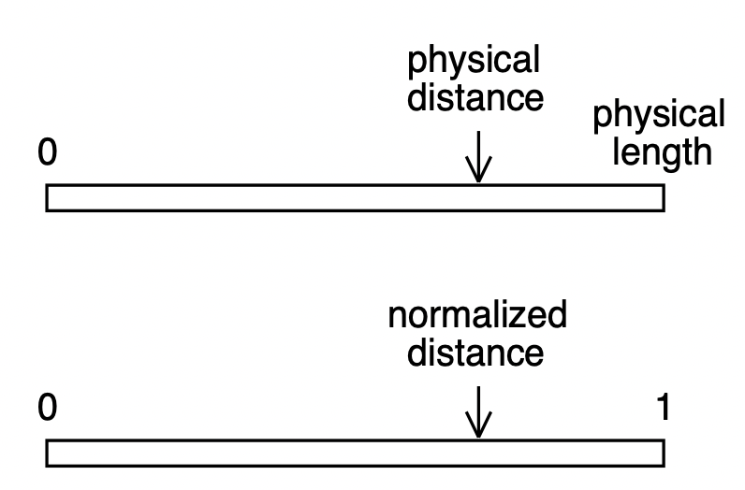
Section and segments
Example:
Length of a section named dend is 10 µm, if we want to examine the voltage at location which is after 7 µm from point 0, we should do: dend(0.7).v
Also if the length of the section is 100 µm and we want to examine location 70 µm we would write dend(0.7).v
Dendrite

Slide 9
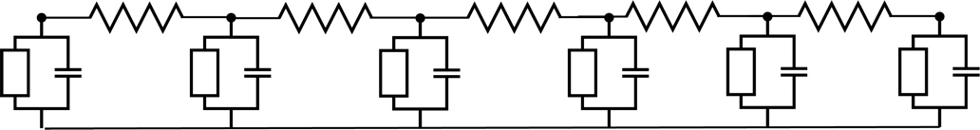
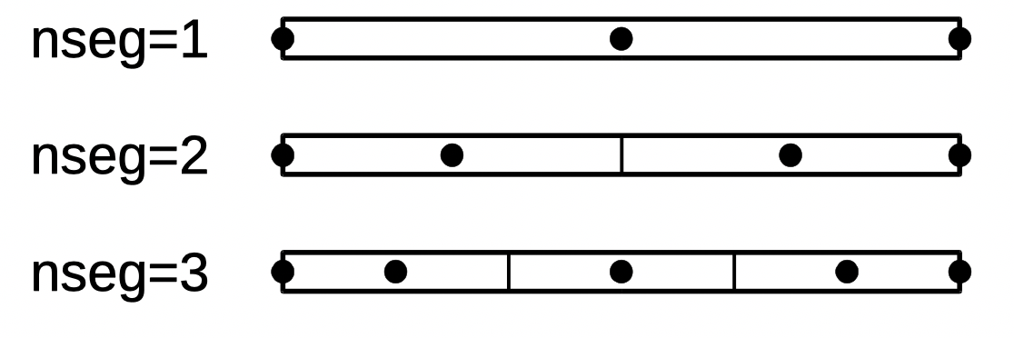
Section and segments
Dendrite
dend(0.1).v
dend(0.4).v

Slide 10
Ball and Stick model
#########################
# # Set up experiment # #
#########################
stim = h.IClamp(h.soma(0.5)) # add a current clamp the # the middle of the soma
stim.delay = 10 # ms
stim.dur = 100
stim.amp = 0.1 # nA
soma_v = h.Vector() # set up a recording vector
soma_v.record(h.soma(0.5)._ref_v) # record voltage at the #middle of the soma
# Record voltage from all segments in the dendrite
dend_vs = []
for seg in h.dend:
dend_vs.append(h.Vector())
dend_vs[-1].record(seg._ref_v)
t = h.Vector()
t.record(h._ref_t) #record time.
h.v_init = -70 # set starting voltage
h.tstop = 200 # set simulation time
h.run() # run simulation
Soma
Dendrite
R_{s}
R_{d0}
R_{d3}

Slide 11
Ball and Stick model
################
# Plot Results #
################
plt.figure(figsize=(8,5))
plt.plot(t, soma_v,color='k',label='soma(0.5)')
for i,v in list(enumerate(dend_vs))[::3]:
plt.plot(t, v, color=(0,0,0.5+0.5*i/len(dend_vs)),
label = 'dend({:.2})'.format(i/len(dend_vs)))
Soma
Dendrite
R_{s}
R_{d0}
R_{d3}
Notes:
Exercise:
Inject current to the other end of the cable to location 1 of dend and plot the voltage in different location on the dendrite and soma

Slide 12
Ball and Stick model
###########################
# Add HH channels to soma #
###########################
h.tstop = 25
stim.dur = 5
h.soma.insert('kv') # add potassium channel
h.soma.gbar_kv = 2000 # set the potassium conductance
h.soma.insert('na') # add sodium channel
h.soma.gbar_na = 10000 # set the sodium conductance
h.celsius = 30
Soma
Dendrite
R_{s}
R_{d0}
R_{d3}
Notes:
To draw the spike at different location

Slide 13
Inhibition location
Pyramidal cell
Martionti cells (SST+)
Basket cells (PV+)

Slide 14
Inhibition location

Slide 15
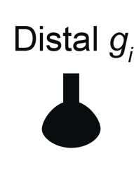

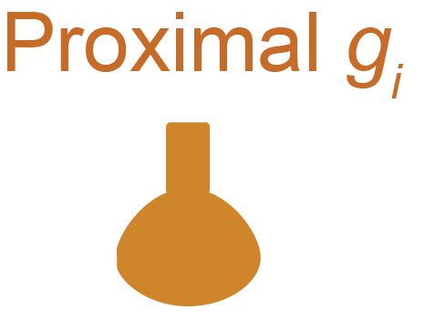

Inhibition location

Slide 16
Inhibition location:
#Now we create 20 AMPA_NMDA synapses:
hotspot_NMDA_synapses = []
hotspot_NMDA_netcons = []
hotspot_NMDA_netstims = []
for j in range(20):
hotspot_NMDA_synapses.append(h.ProbAMPANMDA2_RATIO(0.6, sec = h.dend))
hotspot_NMDA_netstims.append(h.NetStim(0.6, sec = h.dend))
hotspot_NMDA_netcons.append(h.NetCon(hotspot_NMDA_netstims[j], hotspot_NMDA_synapses[j]))
hotspot_NMDA_synapses[j].tau_r_AMPA = 0.33 # AMPA rise time
hotspot_NMDA_synapses[j].tau_d_AMPA = 1 # AMPA decay time
hotspot_NMDA_synapses[j].e=0
hotspot_NMDA_synapses[j].tau_r_NMDA = 0.23 # NMDA rise time
hotspot_NMDA_synapses[j].tau_d_NMDA = 55 # NMDA decay time
hotspot_NMDA_synapses[j].Dep = 0
hotspot_NMDA_synapses[j].Fac = 0
hotspot_NMDA_netcons[j].weight[0]= 0.5 # strength of the synapse – !The conductance!
hotspot_NMDA_netstims[j].number = 9e9 # number of synaptic activation
hotspot_NMDA_netstims[j].noise = 1 # randomness
hotspot_NMDA_netstims[j].interval = 50 # mean time between spikes |50 ms = 20 Hz|
###################
# # Build Model # #
###################
v_rest = -60 # the baseline voltage.
h("create soma")
h.soma.L = 7
h.soma.diam = 7
h.soma.Ra = 100
h.soma.insert('pas')
h.soma.g_pas = 1/20000
h.soma.e_pas = v_rest
h.soma.insert('na') # insert active conductances to the soma.
h.soma.gbar_na = 5000 # set the Na conductance
h.soma.insert('kv')
h.soma.gbar_kv = 1500 # set the K conductance
h.celsius = 30
h("create dend")
h.dend.L = 700
h.dend.diam = 1
h.dend.Ra = 100
h.dend.insert('pas')
h.dend.e_pas = v_rest
h.dend.g_pas = 1/20000
h.dend.connect(h.soma, 1, 0) #connect the end of the soma to the start of the dendrite
##@@ set number of segement!!!!
h("forall { nseg = int((L/(0.1*lambda_f(100))+0.9)/2)*2 + 1 }")

Slide 17
Inhibition location:
#########################
# # Set up experiment # #
#########################
#create one inhibitory synapse at location 0.2
on_path_inhibition = h.Exp2Syn(0.2, sec = h.dend)
on_path_inhibition.tau1 = 0.01
on_path_inhibition.tau2 = 9e9
on_path_inhibition.e = v_rest # This value is what sets the synapse to be inhibitory
#create one inhibitory synapse at location 0.99
off_path_inhibition = h.Exp2Syn(0.99, sec = h.dend)
off_path_inhibition.tau1 = 0.01
off_path_inhibition.tau2 = 9e9
off_path_inhibition.e = v_rest
#create a NetStim that will activate the synapses at t=1000
inhibition_netstim = h.NetStim(0.5, sec = h.dend) # the location of the NetStim does not matter
inhibition_netstim.number = 1
inhibition_netstim.start = 1000
inhibition_netstim.noise = 0
on_path_netcon = h.NetCon(inhibition_netstim, on_path_inhibition)
off_path_netcon = h.NetCon(inhibition_netstim, off_path_inhibition)

Slide 18
Inhibition location:
#@ set up recording #@
###########################################
# Run simulation with proximal inhibition #
###########################################
inhibition_weight = 0.0025
on_path_netcon.weight[0] = inhibition_weight # activate the on_path synapse
off_path_netcon.weight[0] = 0 # deactivate the off path synapse by changing its conductance to 0
h.run()
soma_v_proximal_inh = list(soma_v)
##########################################
# Run simulation with distal inhibition #
##########################################
on_path_netcon.weight[0] = 0 # deactivate the on path synapse by changing its conductance to 0
off_path_netcon.weight[0] = inhibition_weight # activate only the on_path synapse
h.run()
soma_v_distal_inh = list(soma_v)
Principles Governing the Operation of Synaptic Inhibition in Dendrites
Albert Gidon and Idan Segev, Neuron, 2012
Notes:
Exercise:
Repeat the experiment, but replace the constant inhibition with 20 synapses that fire at 20 hz risetime 0.2 decaytime 2.4 find the right conductance

Slide 20
Layer 5b Pyramidal Cell
from neuron import h
##=================== creating cell object ==========
h.load_file("import3d.hoc")
morphology_file = "morphologies/cell1.asc"
h.load_file("models/L5PCbiophys3.hoc")
h.load_file("models/L5PCtemplate.hoc")
L5PC = h.L5PCtemplate(morphology_file)
1
##==================== recording settings ==============
t = h.Vector()
t.record(h._ref_t)
soma_v = h.Vector()
soma_v.record(L5PC.soma[0](0.5)._ref_v)
nexus_v = h.Vector()
nexus_v.record(L5PC.apic[36](0.9)._ref_v)
stim_current = h.Vector()
stim_current.record(stim._ref_i)
##==================== run simulation ============
h.v_init = -80
h.tstop = 1500
h.celsius = 37
h.run()
1
3
##==================== stimulus settings ======
stim = h.IClamp(L5PC.soma[0](0.5))
stim.dur = 1000
stim.delay = 400
stim.amp = 0.793
2
3
2
Models of Neocortical Layer 5b Pyramidal Cells Capturing a Wide Range of Dendritic and Perisomatic Active Properties
Etay Hay , Sean Hill, Felix Schürmann, Henry Markram, Idan Segev. PLOS Computational Biology 2011

Slide 21

Layer 5b Pyramidal Cell

Slide 22
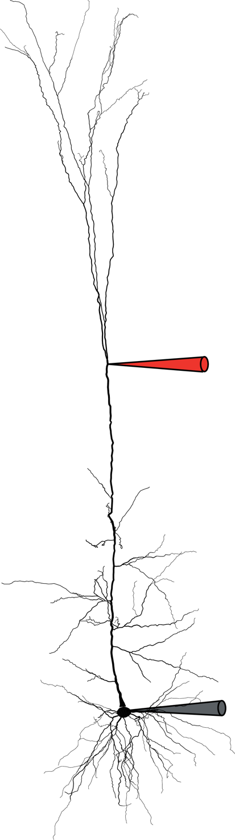
Layer 5b Pyramidal Cell – calcium spike
##==================== stimulus settings ============
stim = h.IClamp(0.5, sec=L5PC.soma[0])
stim.dur = 5
stim.delay = 150
stim_current = h.Vector()
stim_current.record(stim._ref_i)
syn = h.epsp(L5PC.apic[36](0.9))
syn.tau0 = 0.5 #rise time
syn.tau1 = 5 #decay time
syn.onset = stim.delay + 5
syn_current = h.Vector()
syn_current.record(syn._ref_i)

Slide 23
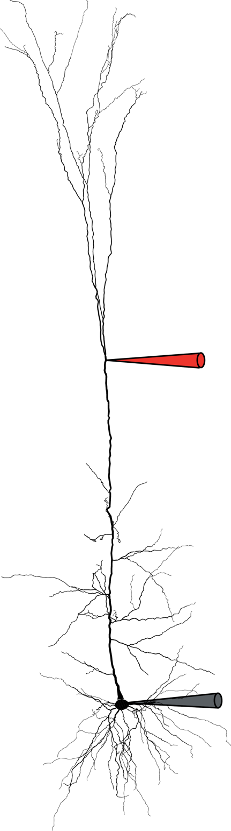
# Only EPSP-like current
syn.imax = 0.5
stim.amp = 0
h.run()
plot_result(...)
# Only small step current
syn.imax = 0
stim.amp = 1.9
h.run()
plot_result(...)
Recording
# both step and EPSP-like currents
syn.imax = 0.5
stim.amp = 1.9
h.run()
plot_result(...)
Models of Neocortical Layer 5b Pyramidal Cells Capturing a Wide Range of Dendritic and Perisomatic Active Properties
Etay Hay , Sean Hill, Felix Schürmann, Henry Markram, Idan Segev. PLOS Computational Biology 2011
Notes:
Exercise:
Add a synapse to a random location on the neuron (use the GUI) and check what is the epsp that is creates.
Add more synapses to a random locations on the neuron (use the GUI) and check how many synapses are needed to make the neuron fire a spike

Slide 24
Timed inhibition
Timed Synaptic Inhibition Shapes NMDA Spikes, Influencing Local Dendritic Processing and Global I/O Properties of Cortical Neurons
Michael Doron, Giuseppe Chindemi, Eilif Muller, Henry Markram, Idan Segev. Cell Reports 2017

Slide 25
Basic use of NEURON
Single compartment model
Active conductances
Ball and stick model
Synaptic activation
Full complex multi-compartmental model

Slide 26
Single Neuron models
Mean/field models
Model comparison and validation models
From local circuits to whole-brain models
Brain connectivity

